Slide 1
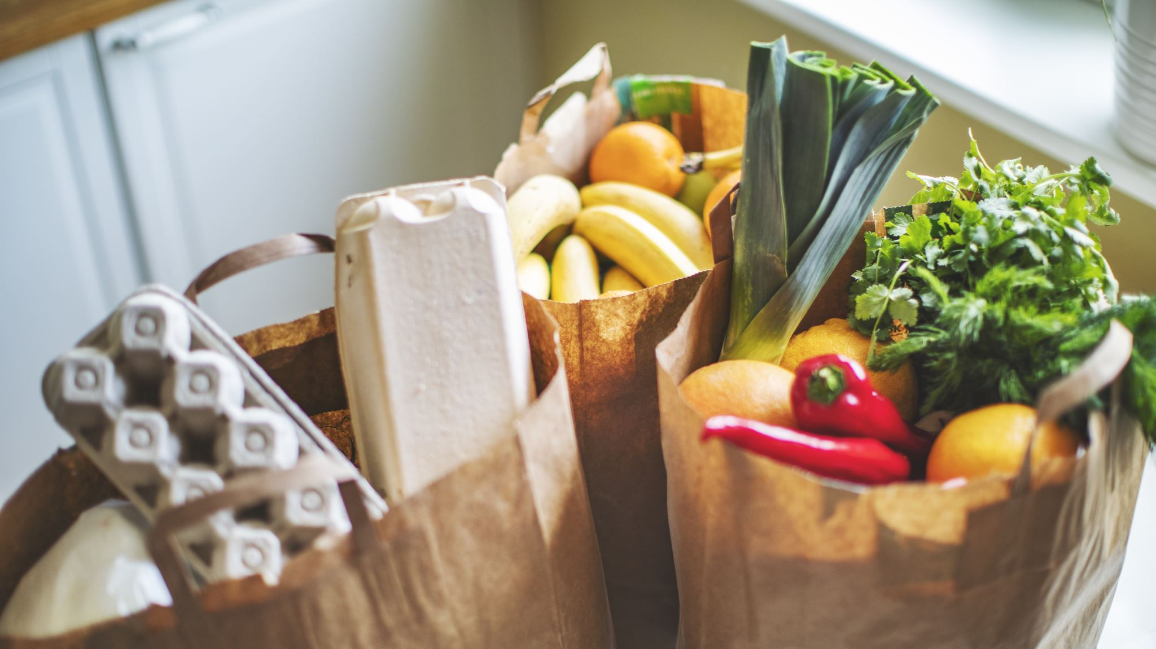
Food Delivery App
Eyal Yemini,
Koren Chen,
Andrey Gorodovsky,
David Koldertsov,
Ariel Benillouche

Slide 2

System Description
UsainWolt makes getting your favorite meals easier than ever. Browse local restaurants, place your order with a few taps, and enjoy delicious food from the comfort of your home with fast, reliable service.

Slide 3
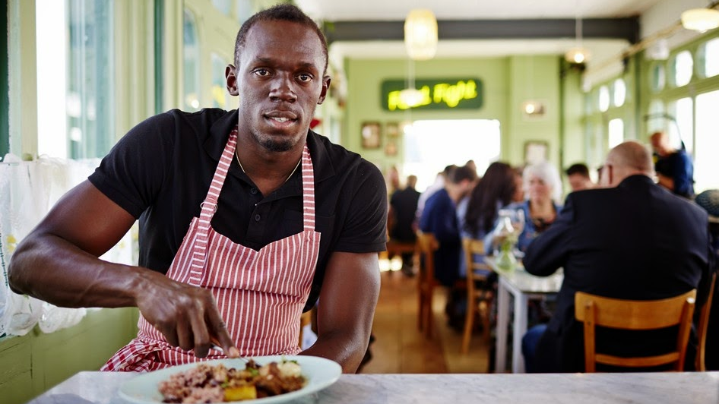
Functionallity
User Database Management: Efficiently handle user information, preferences, and order history.
Restaurant and Menu Management: Seamlessly manage restaurant profiles, menu updates, and availability.
Customer-Restaurant Communication: Facilitate direct communication between customers and restaurants for special requests and inquiries.
Intuitive Graphical User Interface (GUI): User-friendly and visually appealing interface for a seamless browsing and ordering experience.
Serving Relevant, Personalized Information: Provide users with tailored recommendations and relevant promotions based on their preferences and order history.

Slide 4
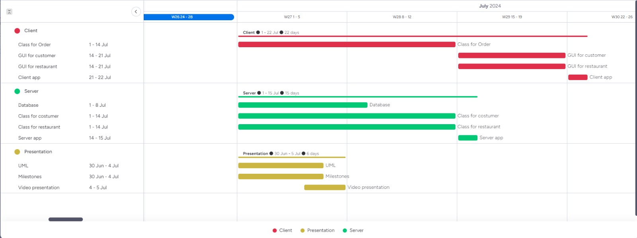
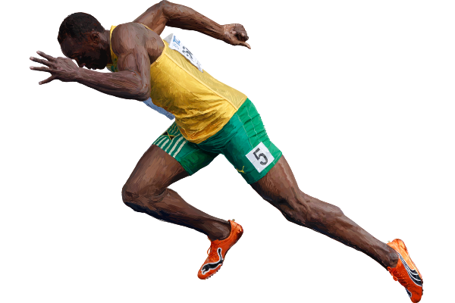
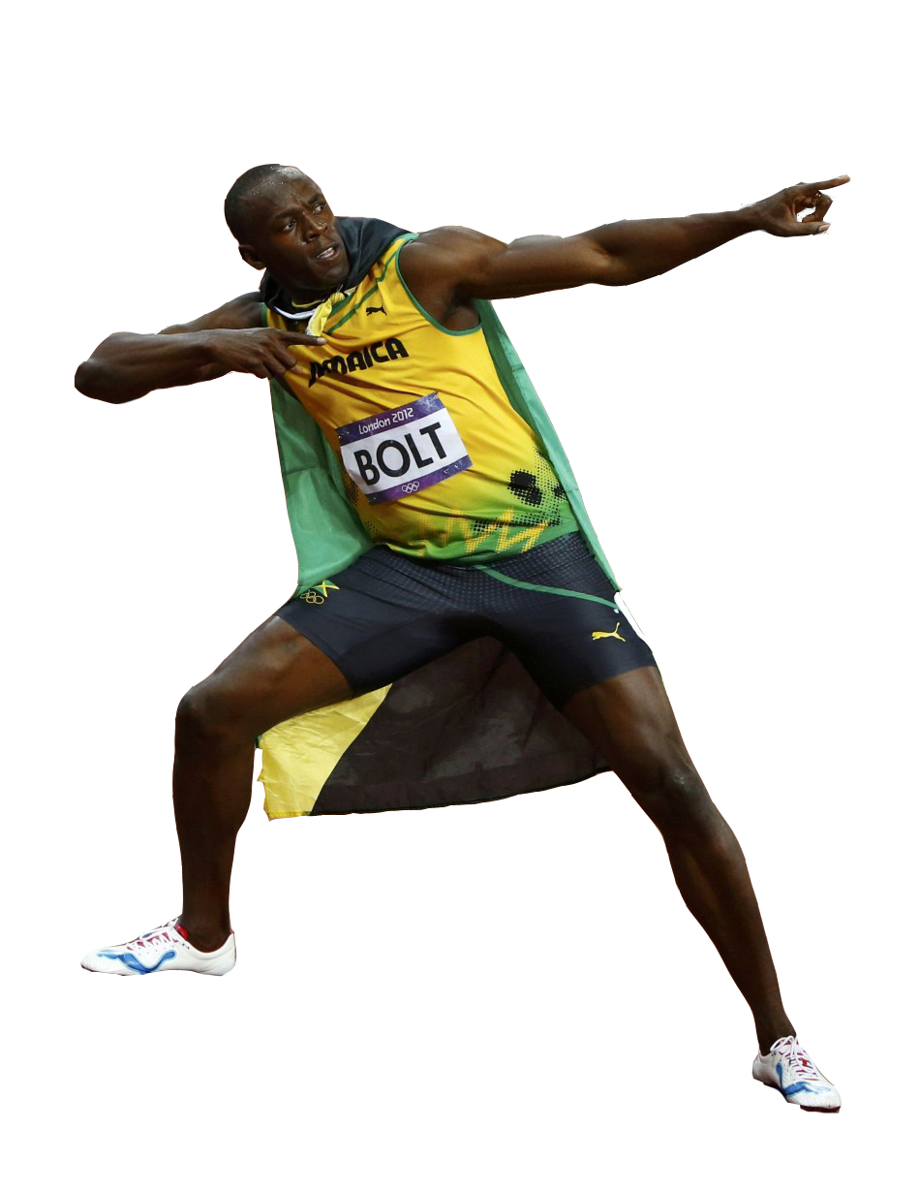
Schedule and Milestones

Slide 5
UML

